Slide 1
Effect of Process Parameters on Attainable Feature Heights in Photoinduced Marangoni Patterning
Aneendya Datta Gupta (Ramakrishna Mission Rahara)
and
Dhruv Kumar (NIT Agartala)

Slide 2
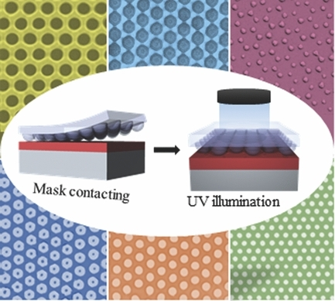
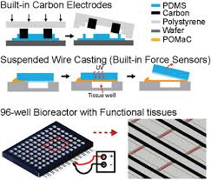
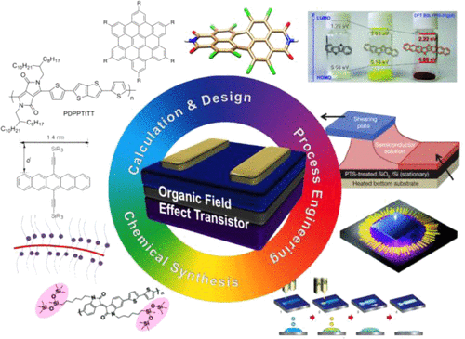
Applications of Patterned Polymer Films
Clockwise:
(1) M. Fang et al.,
Advanced Optical Materials, 2014, 2, 855–860.
(2) Y. Zhao et al., Advanced Healthcare Materials, 2019, 8, 1801187.
(3) J. Mei et al., Journal of the American Chemical Society, 2013, 135, 6724–6746.
One technique to create patterned films – Marangoni patterning

Slide 3
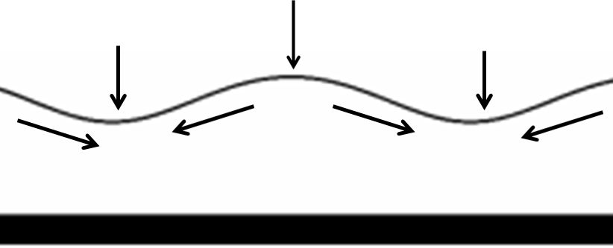
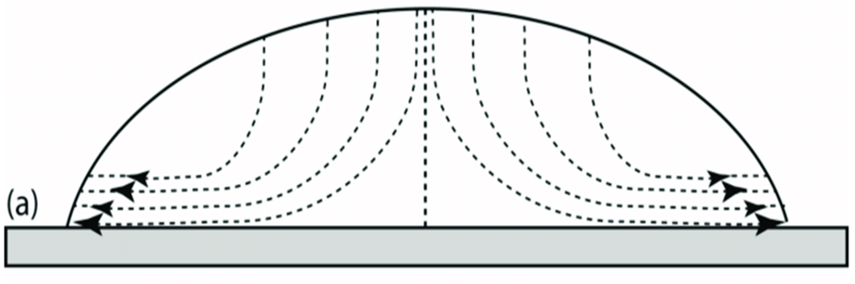

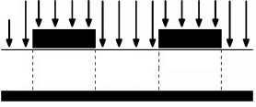
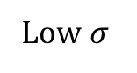
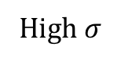
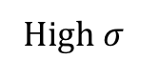
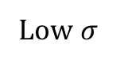
Physical Mechanisms Involved
Low $σ$
Low $σ$
High $σ$
High P
High $σ$
low P
low P
Marangoni Effect
Capillary Leveling Effect
S. Vafaei, Nanomaterials, 2020, 10, 397.
S. K. Stanley et al., Colloids and Surfaces A: Physicochemical and Engineering Aspects, 2020, 603, 125217.
Low C
High C
Low C
Photoproduct Diffusion

Slide 4
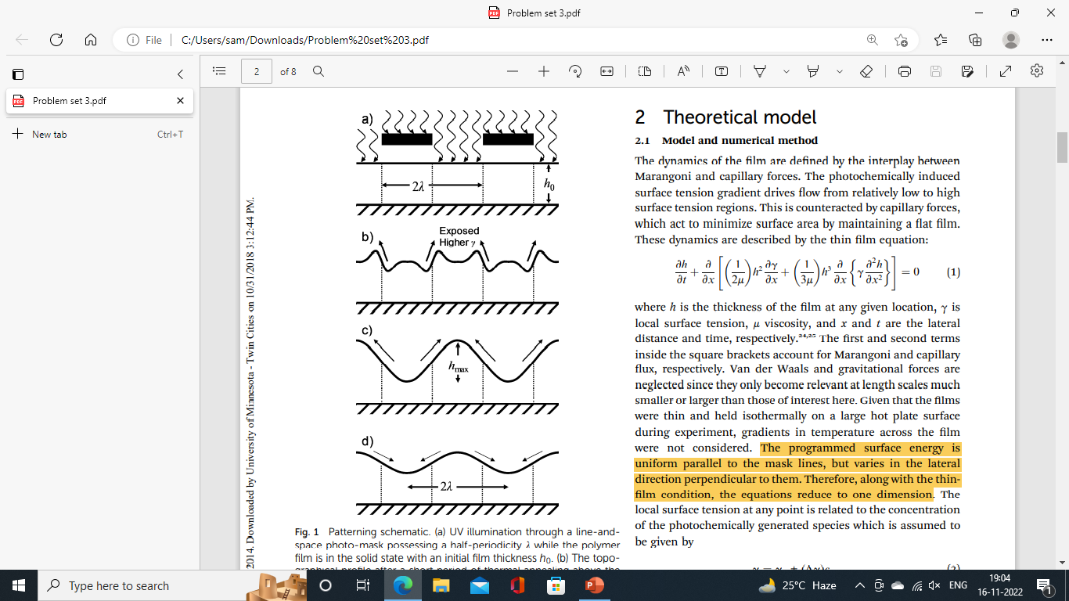

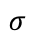
Photochemically Induced Marangoni Patterning
UV light
after short period of thermal annealing
$$σ$$
Marangoni effect
Further annealing
extended thermal annealing
T. A. Arshad et al., Soft Matter, 2014, 10, 8043–8050.
capillary leveling
+
photoproduct diffusion

Slide 5
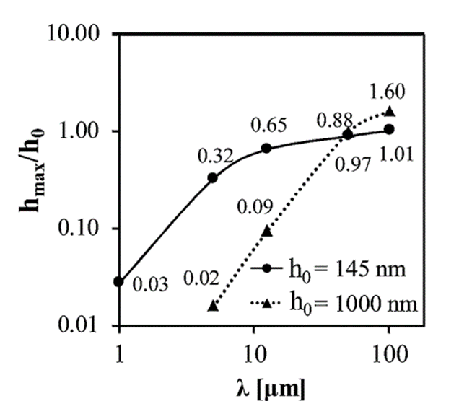
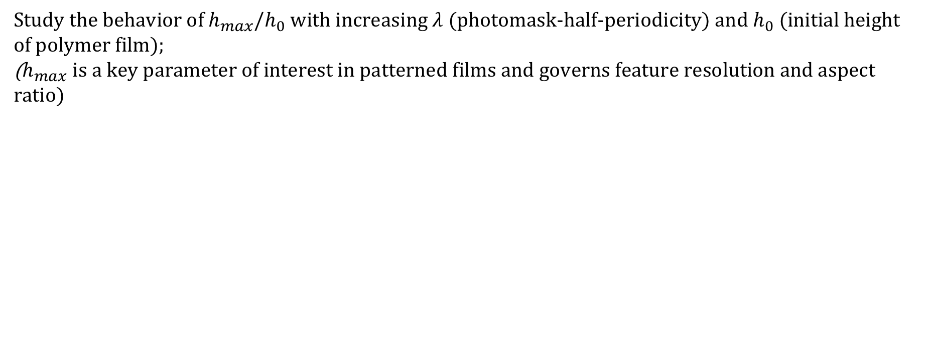
Objective
Study the behavior of $h_{max}/h_{0}$ with increasing $λ$ (photomask-half-periodicity) and $h_{0}$ (initial height of polymer film);
($h_{max}$ is a key parameter of interest in patterned films and governs feature resolution and aspect ratio)
Physical mechanism unclear
T. A. Arshad et al., Soft Matter, 2014, 10, 8043–8050.

Slide 6
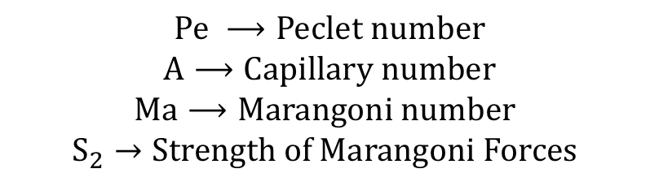
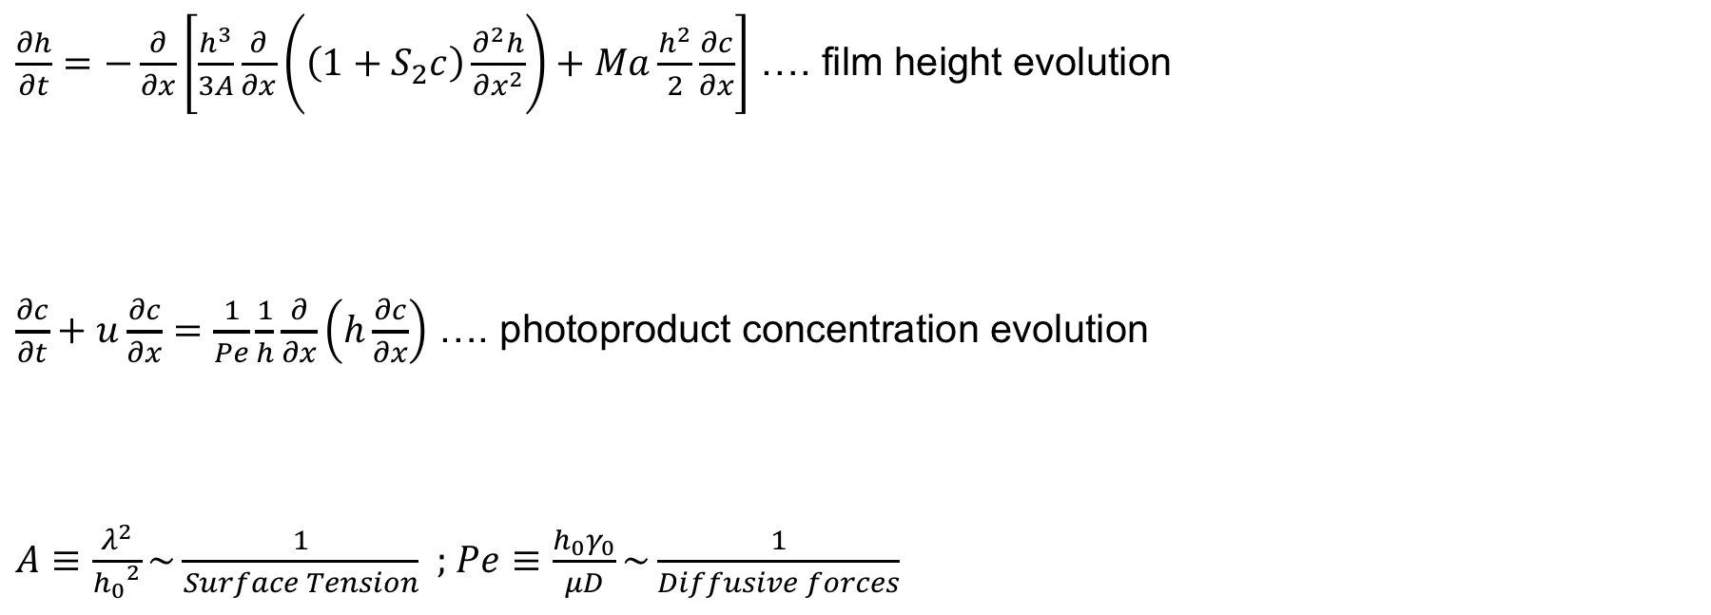
Governing Equations: Mass and Momentum Conservation
$\frac{∂h}{∂t}=−\frac{∂}{∂x}\left[\frac{h^{3}}{3A}\frac{∂}{∂x}\left(\left(1+S_{2}c\right)\frac{∂^{2}h}{∂x^{2}}\right)+Ma\frac{h^{2}}{2}\frac{∂c}{∂x}\right]$ …. film height evolution
$\frac{∂c}{∂t}+u\frac{∂c}{∂x}=\frac{1}{Pe}\frac{1}{h}\frac{∂}{∂x}\left(h\frac{∂c}{∂x}\right)$ …. photoproduct concentration evolution
$A≡\frac{λ^{2}}{{h_{0}}^{2}}\sim \frac{1}{Surface Tension}$ ; $Pe≡\frac{h_{0}γ_{0}}{μD}\sim \frac{1}{Diffusive forces}$
capillary leveling
Marangoni effect
convection
diffusion
$Pe ⟶Peclet number$
$A⟶Capillary number$
$$Ma⟶Marangoni number$$
$$S_{2}→Strength of Marangoni Forces$$

Slide 7
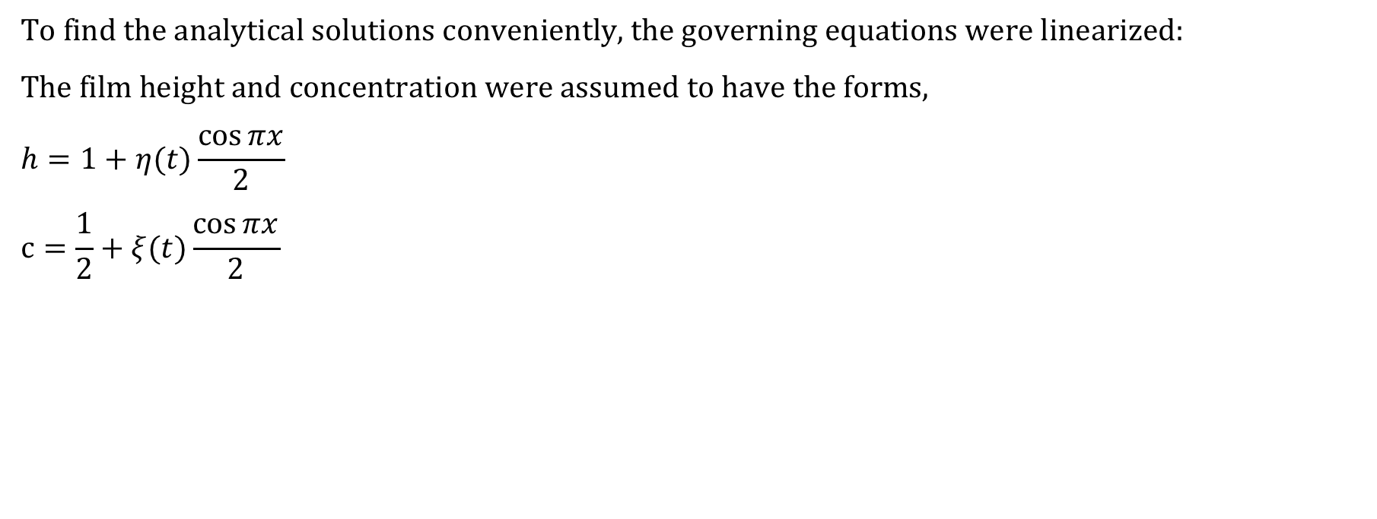
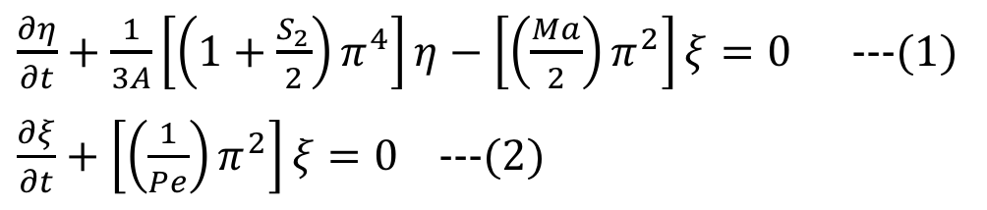
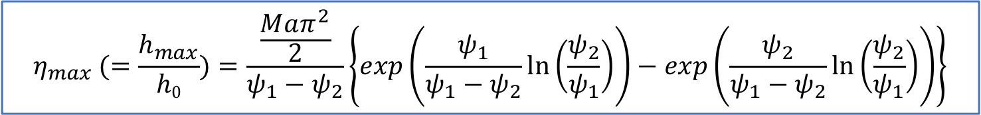
Linear Analysis
To find the analytical solutions conveniently, the governing equations were linearized:
The film height and concentration were assumed to have the forms,
$$h=1+η(t)\frac{\cos{πx}}{2}$$
$$c=\frac{1}{2}+ξ(t)\frac{\cos{πx}}{2}$$
$\frac{∂η}{∂t}+\frac{1}{3A}\left[\left(1+\frac{S_{2}}{2}\right)π^{4}\right]η−\left[\left(\frac{Ma}{2}\right)π^{2}\right]ξ=0$ ---(1)
$\frac{∂ξ}{∂t}+\left[\left(\frac{1}{Pe}\right)π^{2}\right]ξ=0$ ---(2)
$$η_{max} (=\frac{h_{max}}{h0})=\frac{\frac{Maπ^{2}}{2}}{ψ_{1}−ψ_{2}}\left\{exp\left(\frac{ψ_{1}}{ψ_{1}−ψ_{2}}ln⁡\left(\frac{ψ_{2}}{ψ_{1}}\right)\right)−exp\left(\frac{ψ_{2}}{ψ_{1}−ψ_{2}}ln⁡\left(\frac{ψ_{2}}{ψ_{1}}\right)\right)\right\}$$

Slide 8
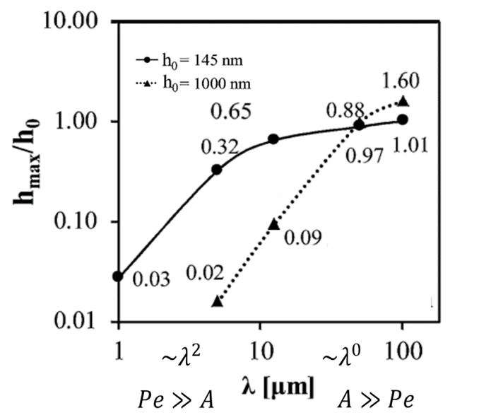
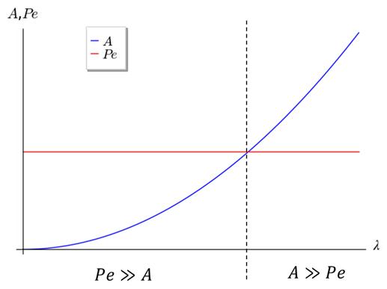
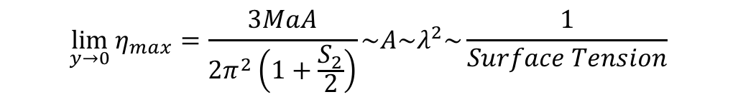
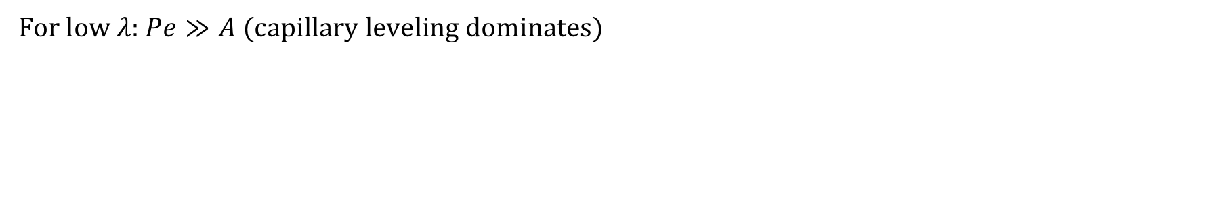
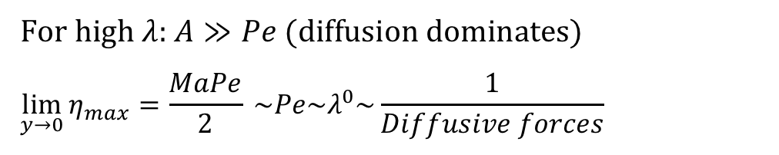
Variation of $h_{max}/h_{0}$ with $λ$
For low $λ$: $Pe≫A$(capillary leveling dominates)
For high $λ$: $A≫Pe$(diffusion dominates)
$$\lim_{y→0}{η_{max}=\frac{MaPe}{2}} \sim Pe{\sim λ}^{0}\sim \frac{1}{Diffusive forces}$$
$$\lim_{y→0}{η_{max}=\frac{3MaA}{2π^{2}\left(1+\frac{S_{2}}{2}\right)}}\sim A\sim λ^{2}\sim \frac{1}{Surface Tension}$$

Slide 9
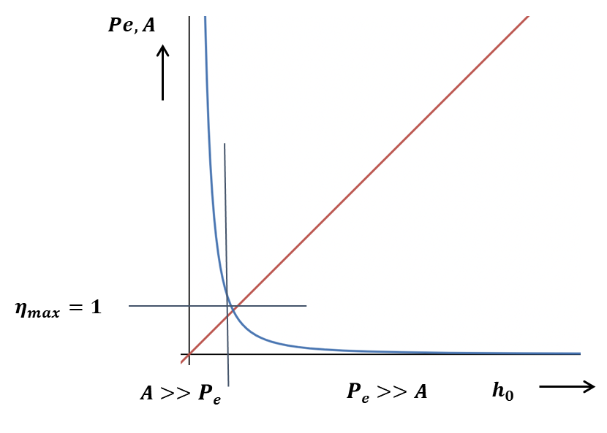
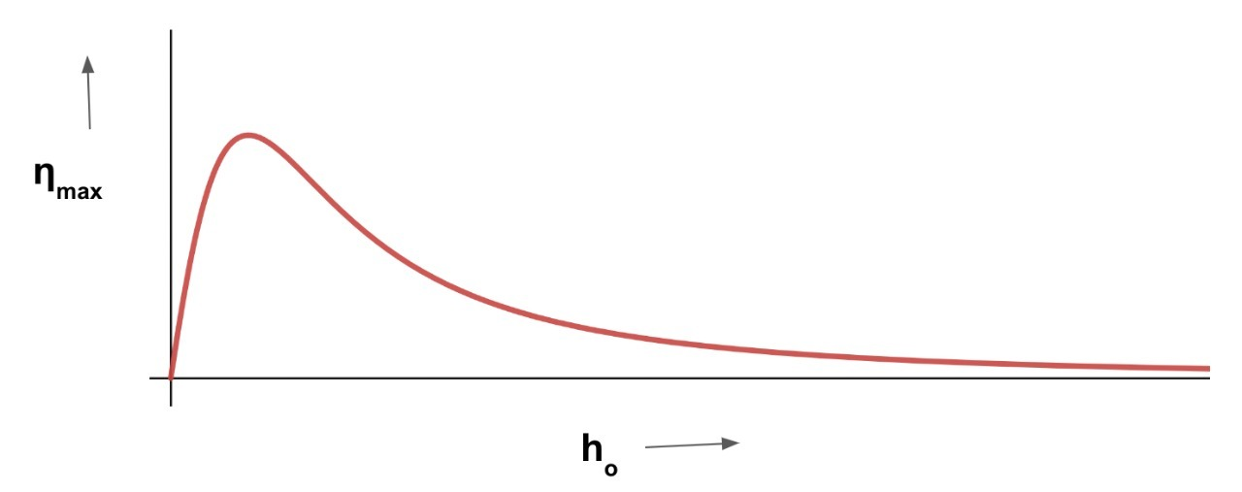
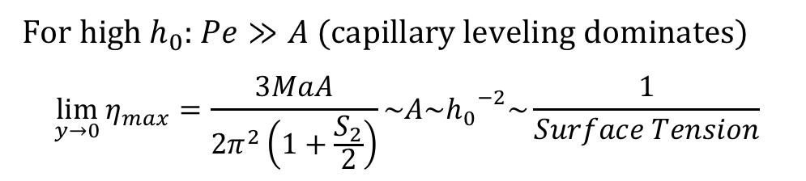
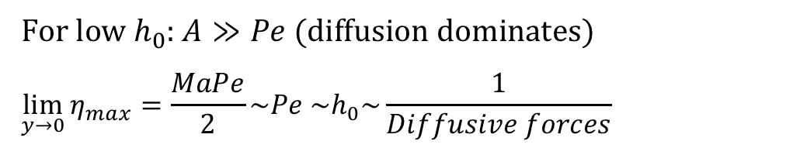
Variation of $h_{max}/h_{0}$ with $h_{0}$
For l$ow h_{0}$: $A≫Pe$(diffusion dominates)
$$\lim_{y→0}{η_{max}=\frac{MaPe}{2}}\sim Pe \sim h_{0}\sim \frac{1}{Diffusive forces}$$
For h$igh h_{0}$: $Pe≫A$(capillary leveling dominates)
$$\lim_{y→0}{η_{max}=\frac{3MaA}{2π^{2}\left(1+\frac{S_{2}}{2}\right)}}\sim A\sim {h_{0}}^{−2}\sim \frac{1}{Surface Tension}$$

Slide 10
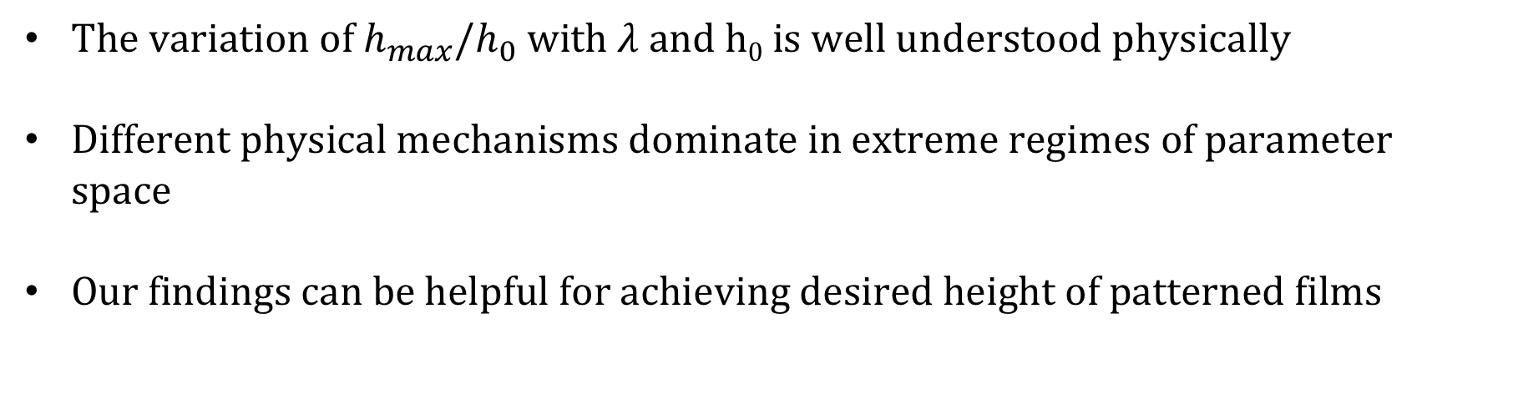
Key findings
The variation of $h_{max}/h_{0}$ with $λ$ and h₀ is well understood physically
Different physical mechanisms dominate in extreme regimes of parameter space
Our findings can be helpful for achieving desired height of patterned films

Slide 11
Supplementary slides

Slide 12
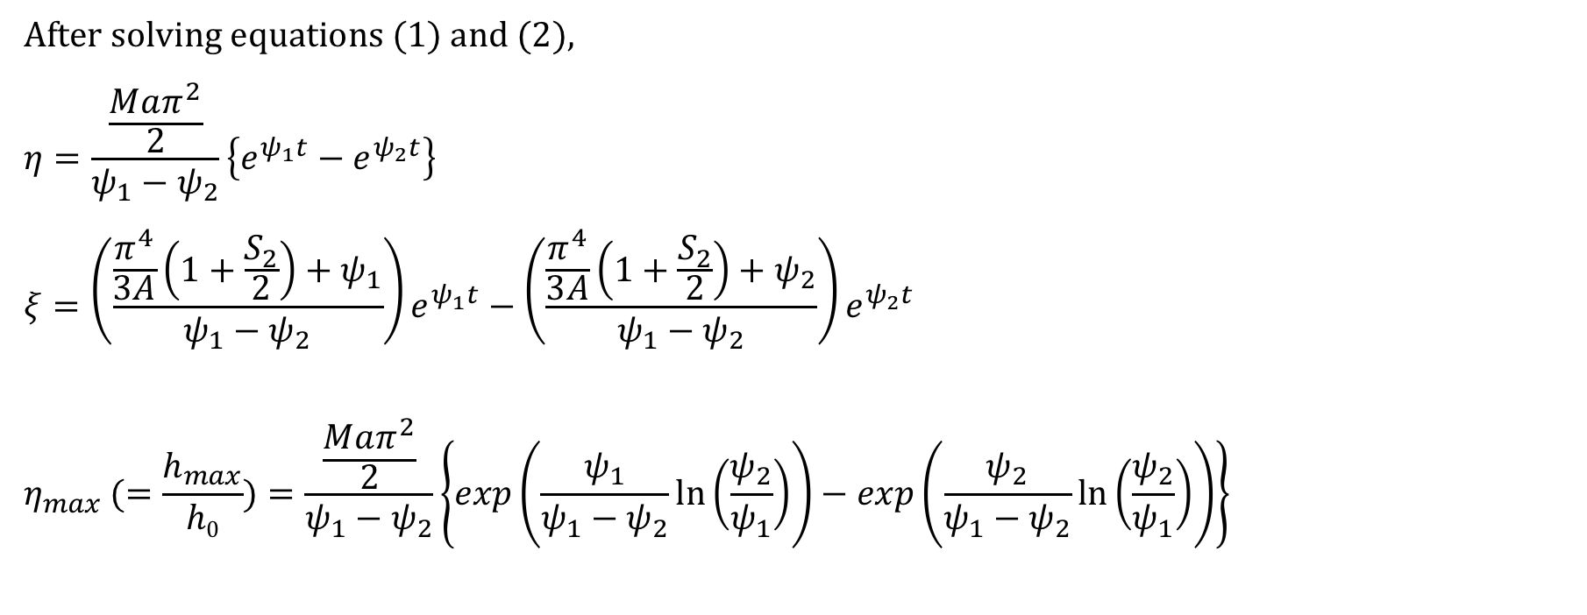
Analytical expression for $\frac{h_{max}}{h0}$ (or $η_{max}$)
After solving equations (1) and (2),
$$η=\frac{\frac{Maπ^{2}}{2}}{ψ_{1}−ψ_{2}}\left\{e^{ψ_{1}t}−e^{ψ_{2}t}\right\}$$
$$ξ=\left(\frac{\frac{π^{4}}{3A}\left(1+\frac{S_{2}}{2}\right)+ψ_{1}}{ψ_{1}−ψ_{2}}\right)e^{ψ_{1}t}−\left(\frac{\frac{π^{4}}{3A}\left(1+\frac{S_{2}}{2}\right)+ψ_{2}}{ψ_{1}−ψ_{2}}\right)e^{ψ_{2}t}$$
$$η_{max} (=\frac{h_{max}}{h0})=\frac{\frac{Maπ^{2}}{2}}{ψ_{1}−ψ_{2}}\left\{exp\left(\frac{ψ_{1}}{ψ_{1}−ψ_{2}}ln⁡\left(\frac{ψ_{2}}{ψ_{1}}\right)\right)−exp\left(\frac{ψ_{2}}{ψ_{1}−ψ_{2}}ln⁡\left(\frac{ψ_{2}}{ψ_{1}}\right)\right)\right\}$$

